Slide 1
What are the chances?
I N T R O D U C T I O N TO STAT I ST I C S
George Boorman
Curriculum Manager, DataCamp

Slide 2
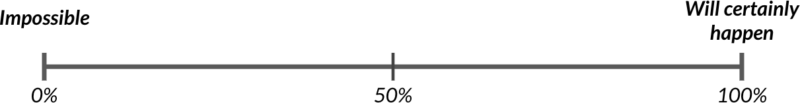
Measuring chance
What's the probability of an event?
# ways event can happen
^{P (event) =} total # of possible outcomes
Example: a coin flip
1 way to get heads 1
^{P (heads) =} 2 possible outcomes ⁼ 2 ^{= 50%}

Slide 3
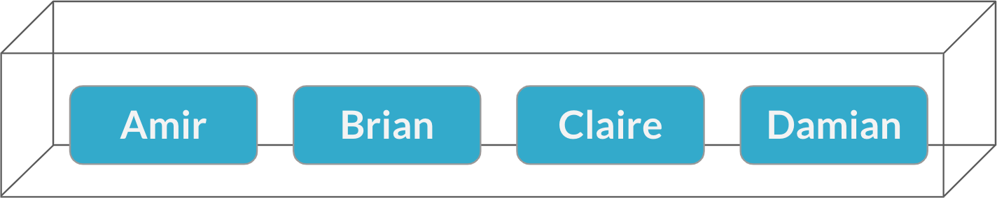
Assigning salespeople
Sampling

Slide 4
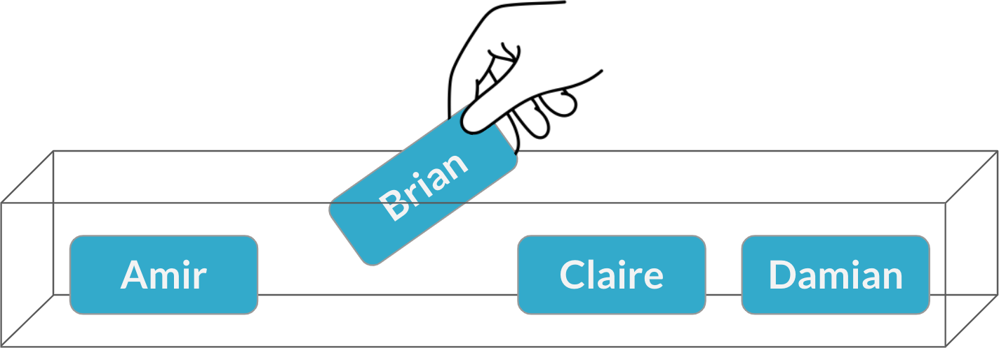
Assigning salespeople
1
P (Brian) = ₄ = 25%

Slide 5
Afternoon meeting
1
P (Brian) = ₄ = 25%
Sampling with replacement

Slide 6
Independent probability
Two events are independent if the probability of the second event does not change based on the outcome of the first event.

Slide 7

Online retail sales
Order Number | Product Type | Net Quantity | Gross Sales | Discounts | Returns | Net Sales
200 | Basket | 13 | 3744.0 | -316.80 | 0.00 | 3427.20
201 | Basket | 12 | 3825.0 | -201.60 | -288.0 | 3335.40
202 | Basket | 17 | 3035.0 | -63.25 | 0.00 | 2971.75
203 | Art & Sculpture | 47 | 2696.8 | -44.16 | 0.00 | 2652.64
204 | Basket | 17 | 2695.0 | -52.50 | -110.00 | 2532.50
¹ Image credit: https://unsplash.com/@rodriguezedm

Slide 8
Probability of an order for a jewelry product
Product Type | Order Count
Basket | 551
Art & Sculpture | 337
Jewelry | 210
Kitchen | 161
Home Decor | 131
... | ...
Total | 1767

Slide 9
Probability of an order for a jewelry product
Order Count(Jewelry)
P (Jewelry) =
Sum(Total Order Count)
210
P (Jewelry) = ₁₇₆₇
P (Jewelry) = 11.88%

Slide 10
Probabilities for all product types
Product Type | Order Count | Probability
Basket | 551 | 31.18%
Art & Sculpture | 337 | 19.07%
Jewelry | 210 | 11.88%
Kitchen | 161 | 9.11%
Home Decor | 131 | 7.41%
... | ... | ...
Total | 1767 | 100%

Slide 11
Conditional probability
I N T R O D U C T I O N TO STAT I ST I C S
George Boorman
Curriculum Manager, DataCamp

Slide 12
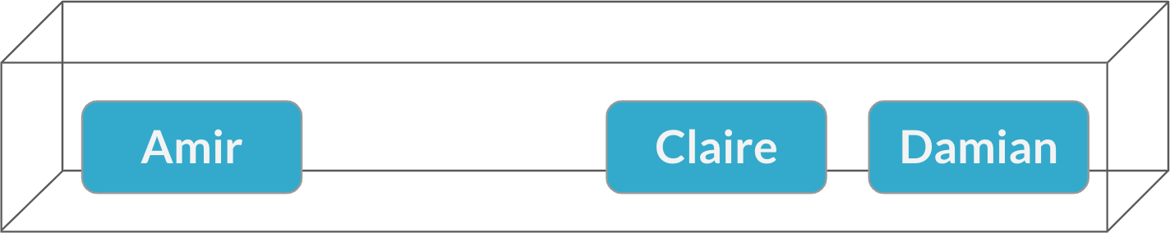
Multiple meetings
Sampling without replacement

Slide 13
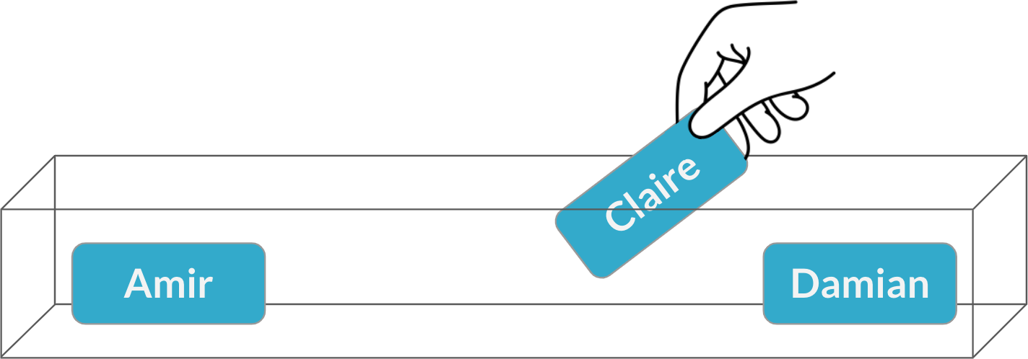
Multiple meetings
Sampling without replacement
1
P (Claire) = ₃ = 33%

Slide 14
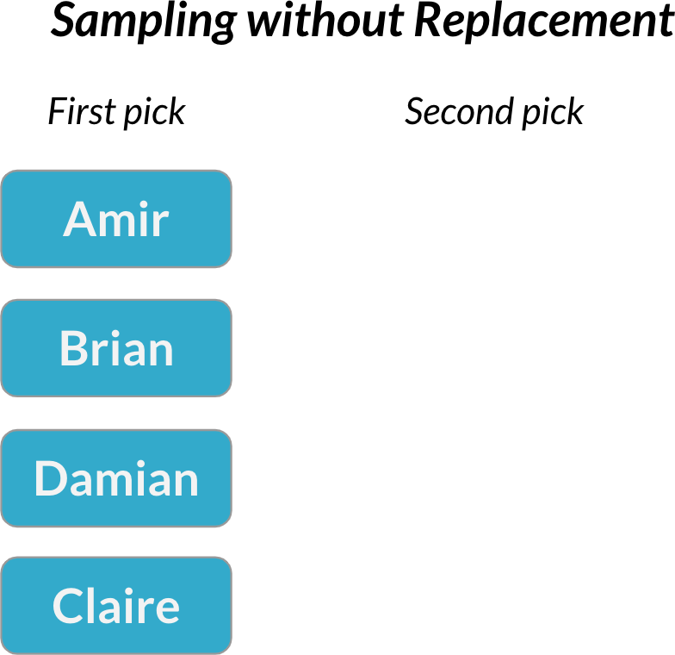
Dependent events
Probability of the second event is affected by the outcome of the first event

Slide 15
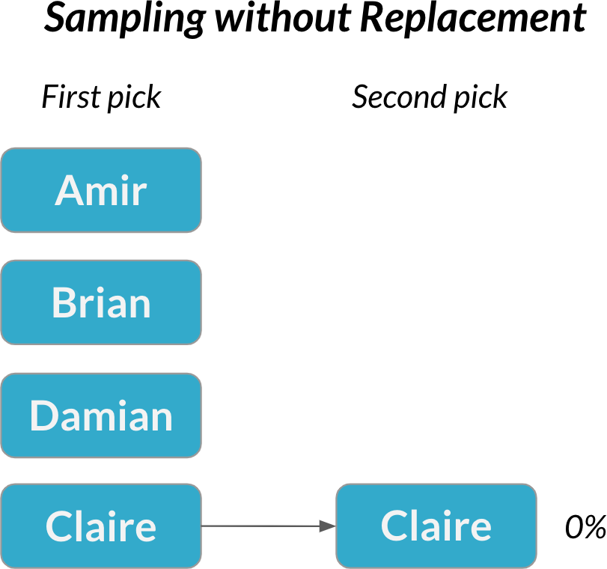
Dependent events
Probability of the second event is affected by the outcome of the first event

Slide 16
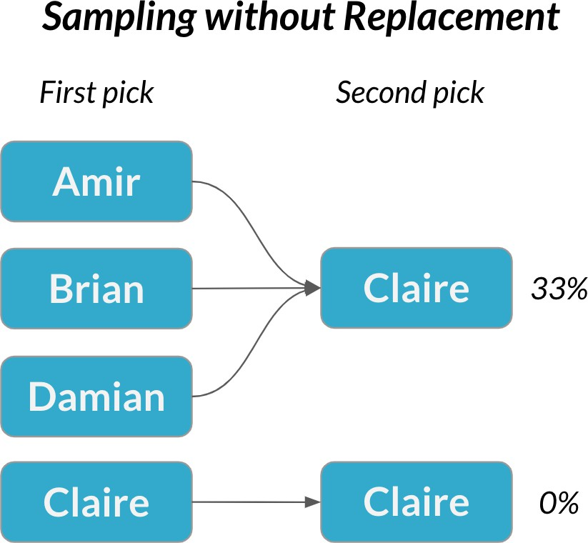
Dependent events
Probability of the second event is affected by the outcome of the first event
Sampling without replacement = each pick is dependent

Slide 17

Conditional probability
Conditional probability is used to calculate the probability of dependent events
The probability of one event is
conditional on the outcome of another
¹ Image credit: https://unsplash.com/@pixeldan

Slide 18
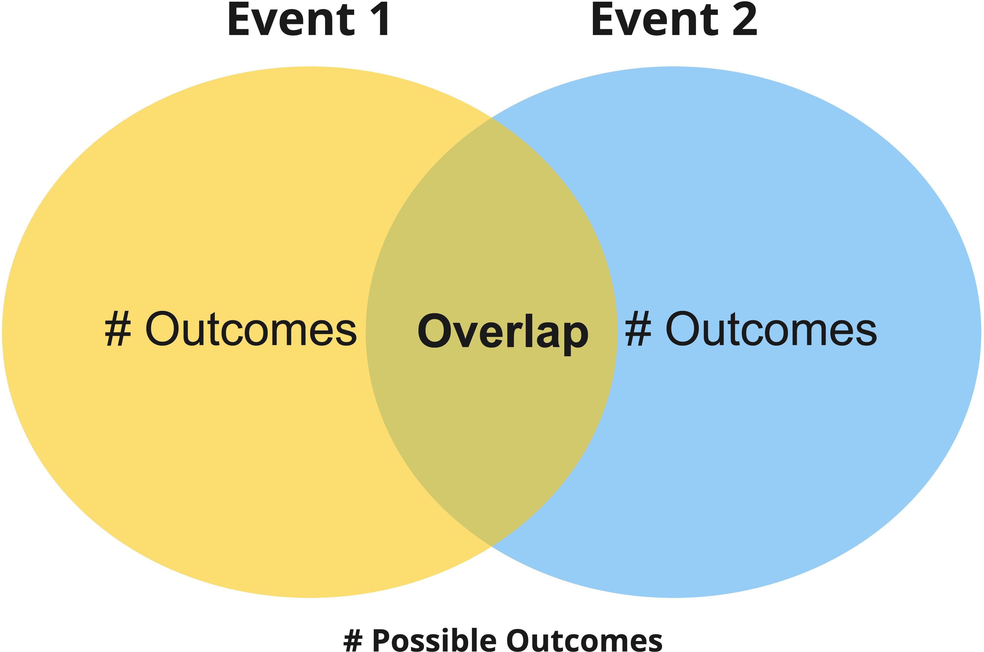
Venn diagrams

Slide 19
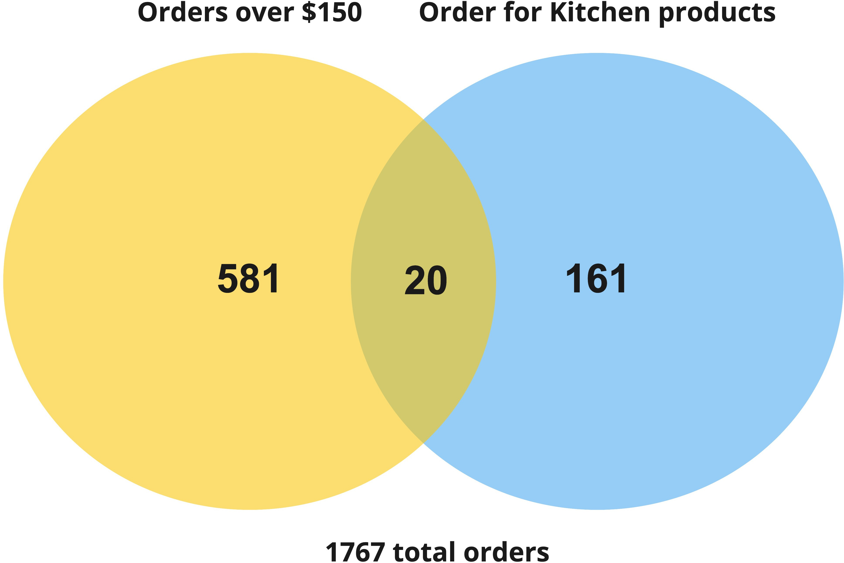
Kitchen sales over $150

Slide 20
Kitchen sales over $150
20
P (Order > 150∣Kitchen) = ¹⁷⁶⁷
181
1767
20
P (Order > 150∣Kitchen) = ₁₈₁

Slide 21
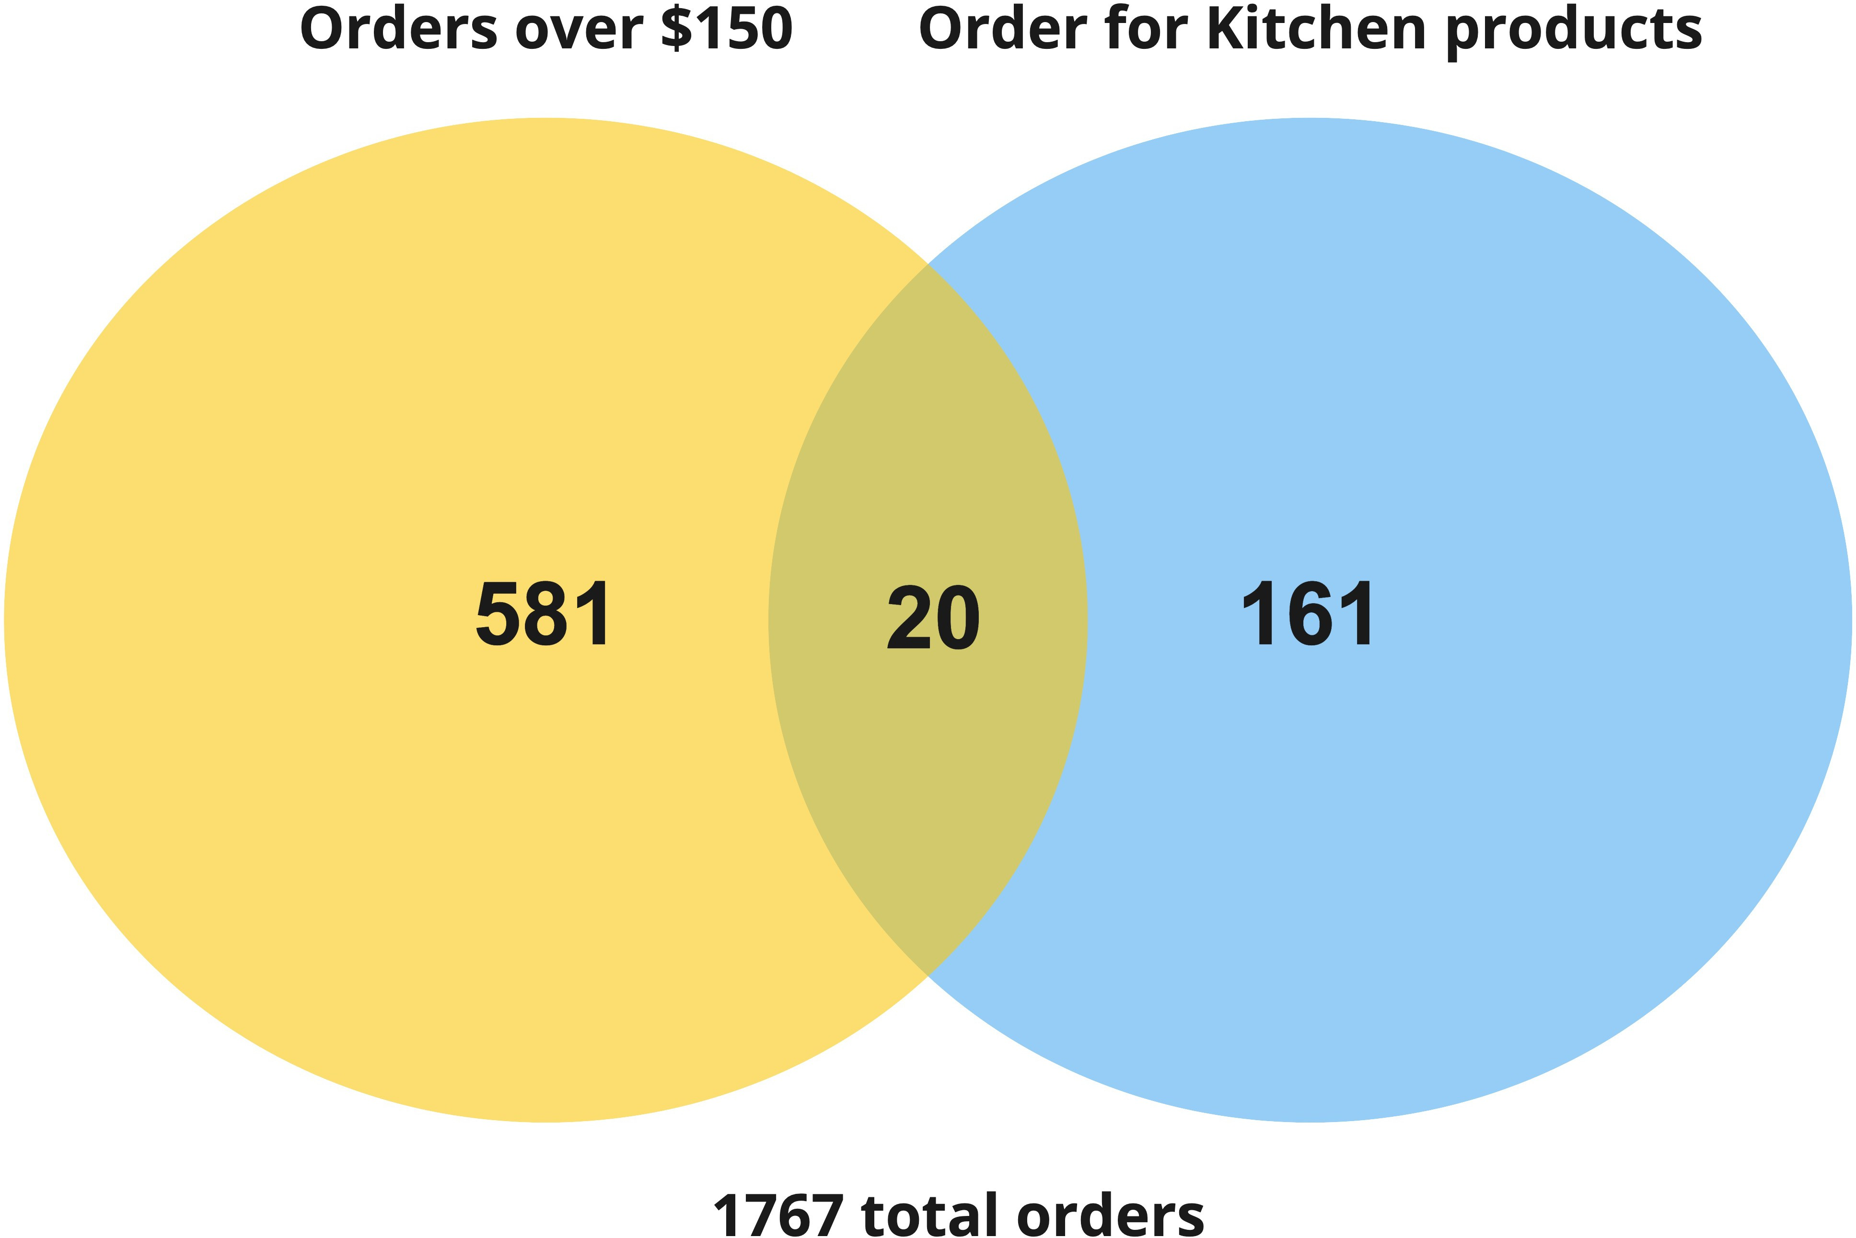
The order of events matters
20
P (Kitchen∣Order > 150) = ¹⁷⁶⁷
601
1767
20
P (Kitchen∣Order > 150) = ₆₀₁

Slide 22
Conditional probability formula
P (A ∩ B)
P (A∣B) =
P (B)
P (A∣B) → Probability of event A, given event B
P (A ∩ B) → Probability of event A and event B Divided by the probability of event B → P (B)

Slide 23
Discrete distributions
I N T R O D U C T I O N TO STAT I ST I C S
George Boorman
Curriculum Manager, DataCamp

Slide 24
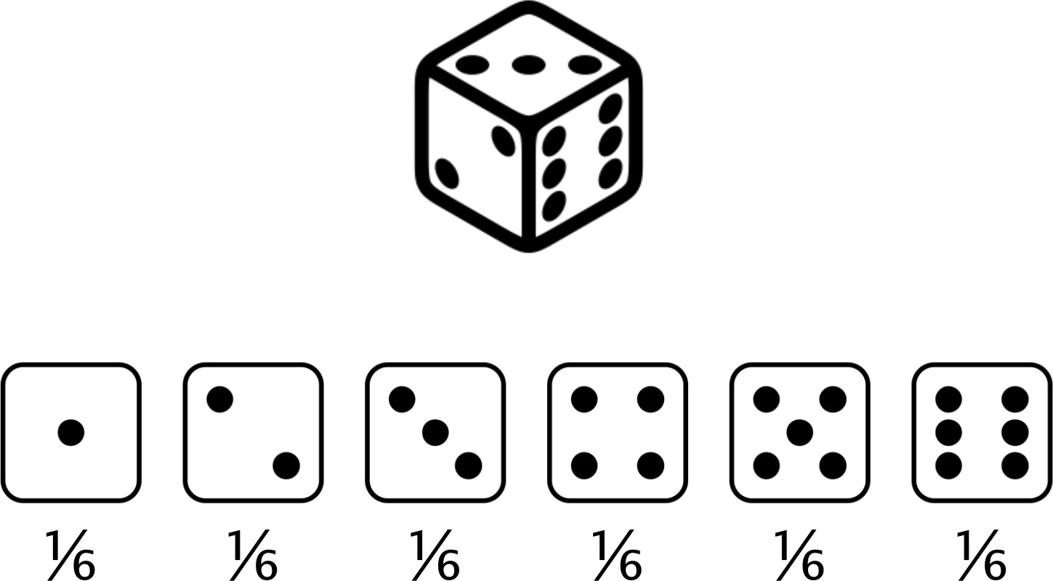
Rolling the dice

Slide 25
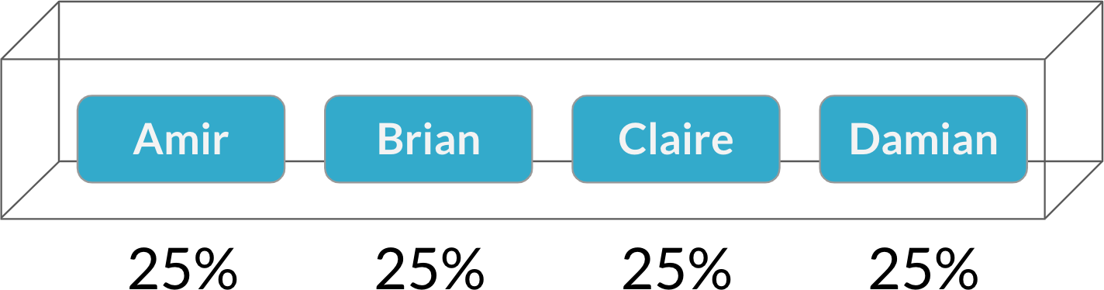
Choosing salespeople

Slide 26
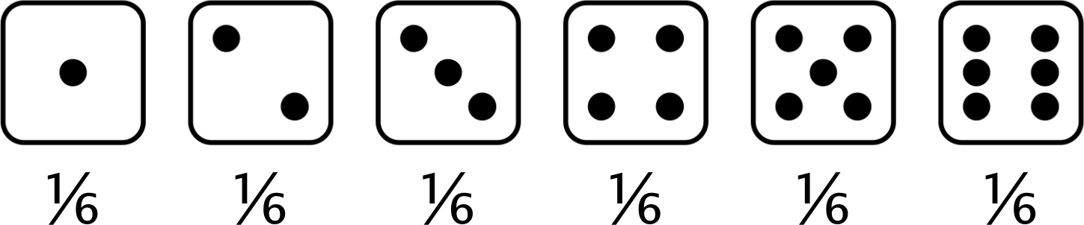
Probability distribution
Describes the probability of each possible outcome in a scenario
Expected value: The mean of a probability distribution
Expected value of a fair die roll =
(1 × ¹ ) + (2 × ¹ ) + (3 × ¹ ) + (4 × ¹ ) + (5 × ¹ ) + (6 × ¹ ) = 3.5
6 6 6 6 6 6

Slide 27

Why are probability distributions important?
Help us to quantify risk and inform decision making
Used extensively in hypothesis testing Probability that the results occurred by chance
¹ Image credit: https://unsplash.com/@timmossholder

Slide 28
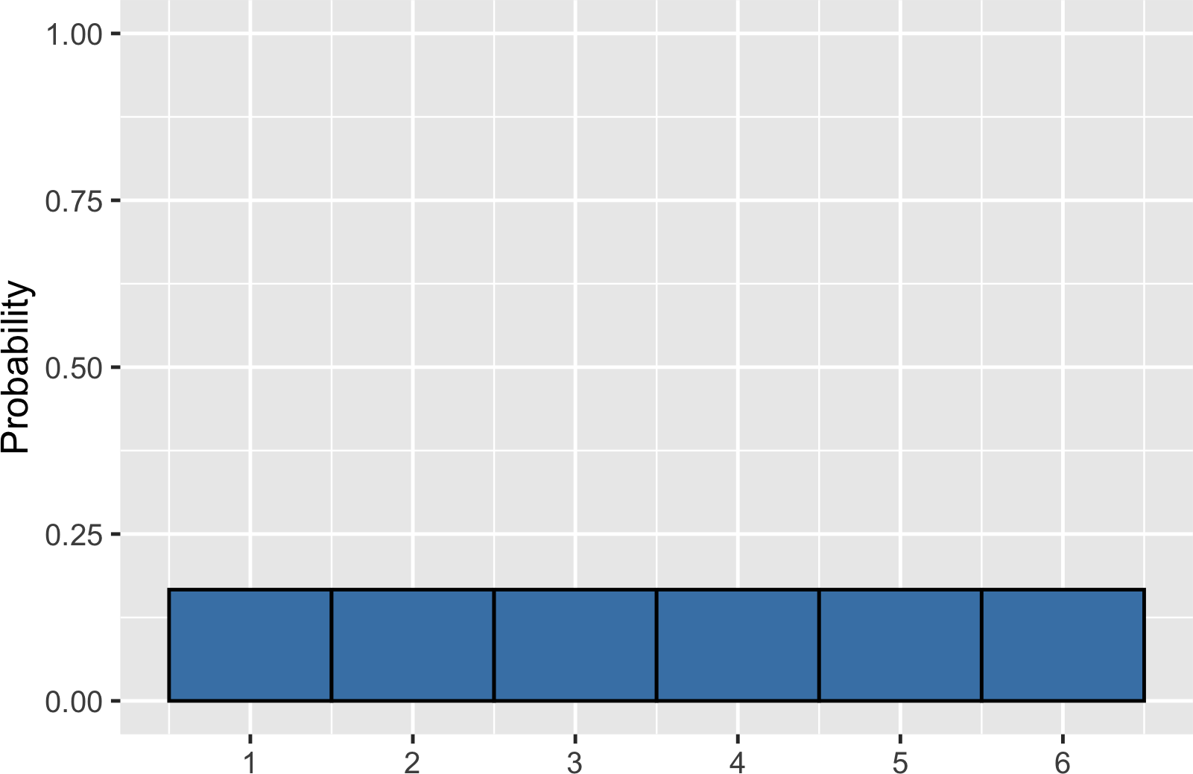
Visualizing a probability distribution

Slide 29
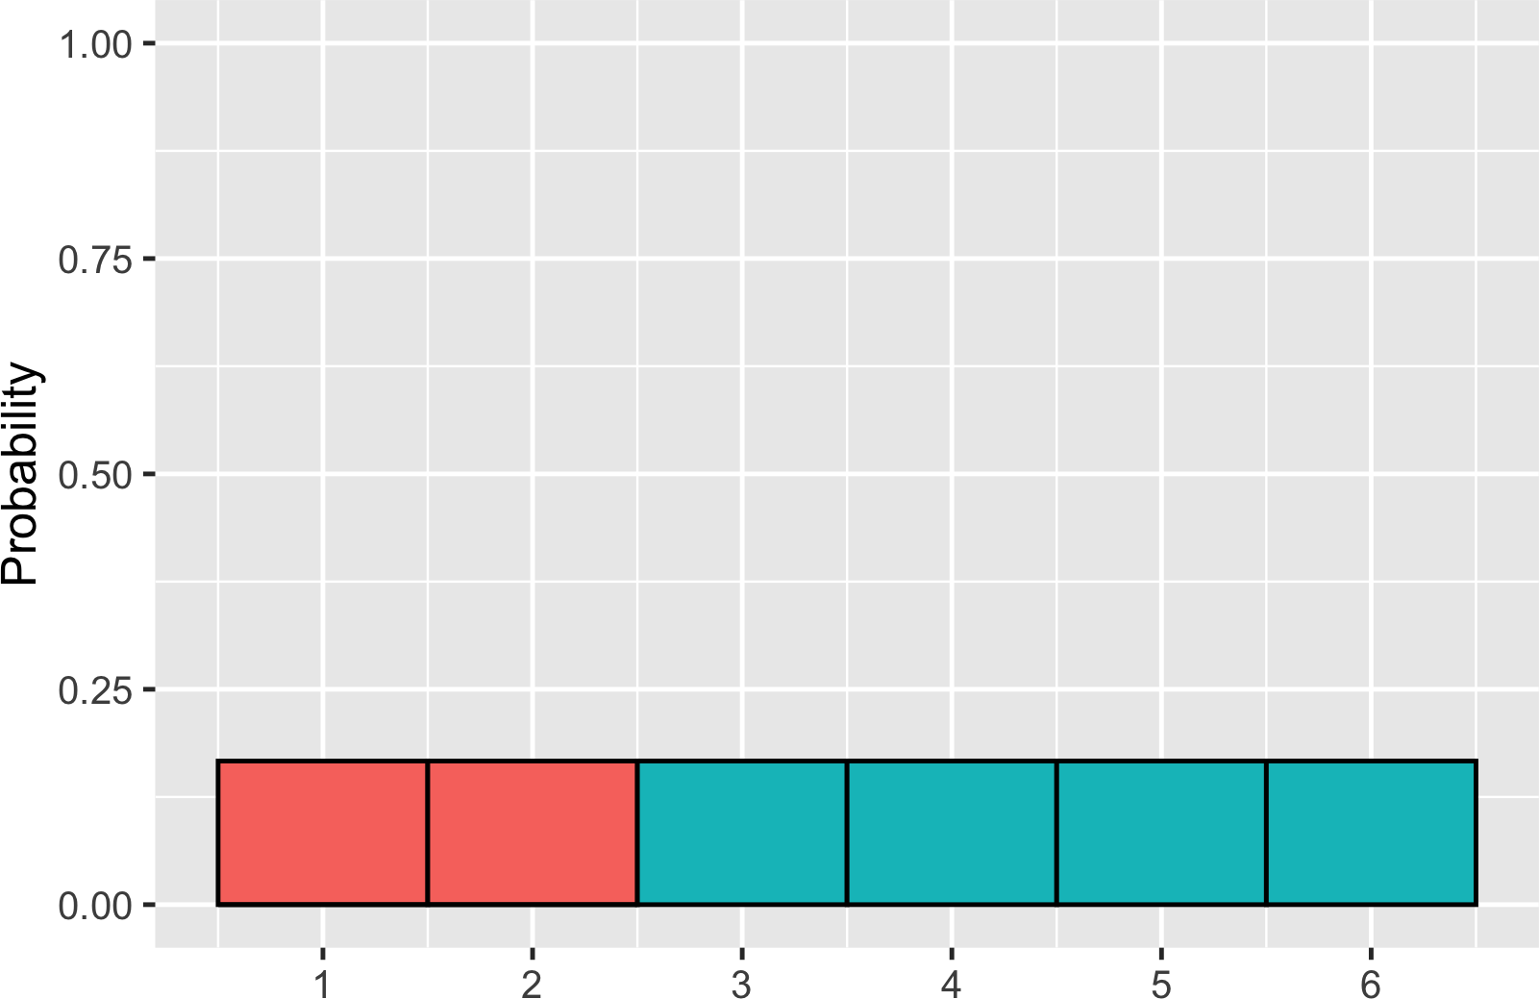
Probability = area
P (die roll) ≤ 2 = ?

Slide 30
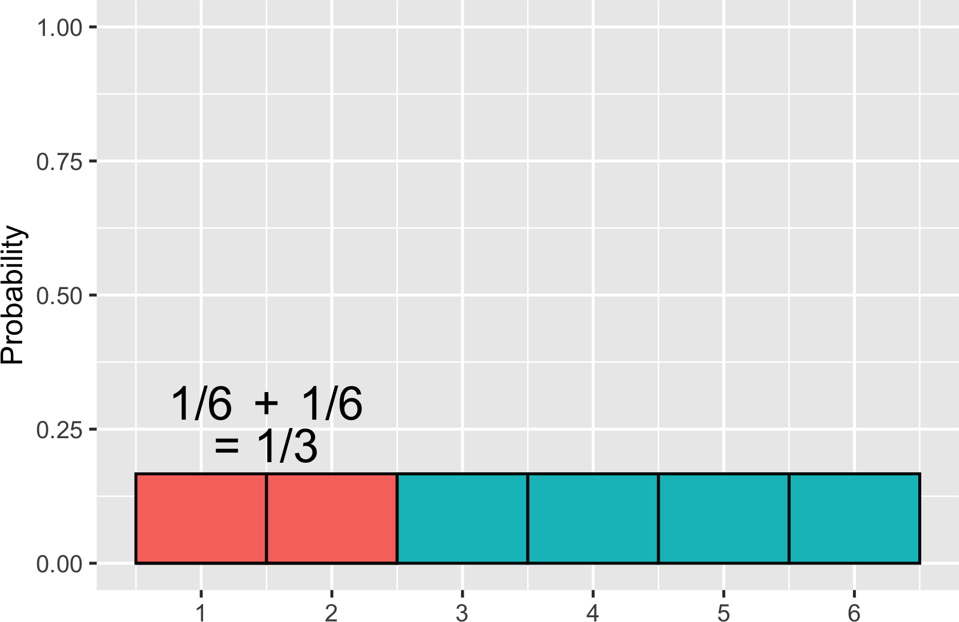
Probability = area
P (die roll) ≤ 2 = 1/3

Slide 31
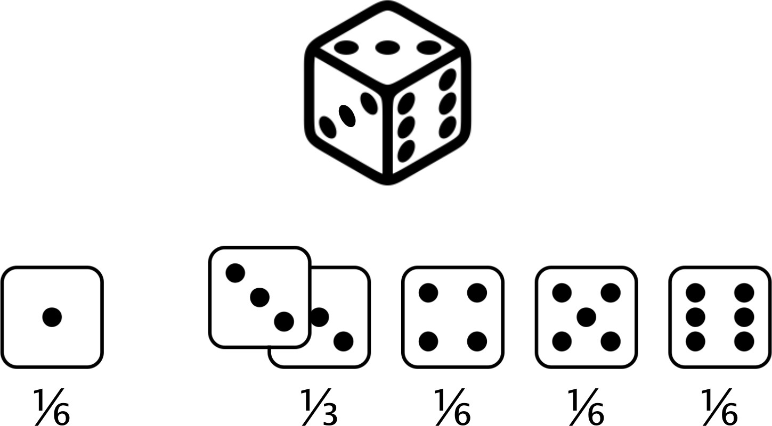
Uneven die
Expected value of uneven die roll =
(1 × ¹ ) + (2 × 0) + (3 × ¹ ) + (4 × ¹ ) + (5 × ¹ ) + (6 × ¹ ) = 3.67
6 3 6 6 6

Slide 32
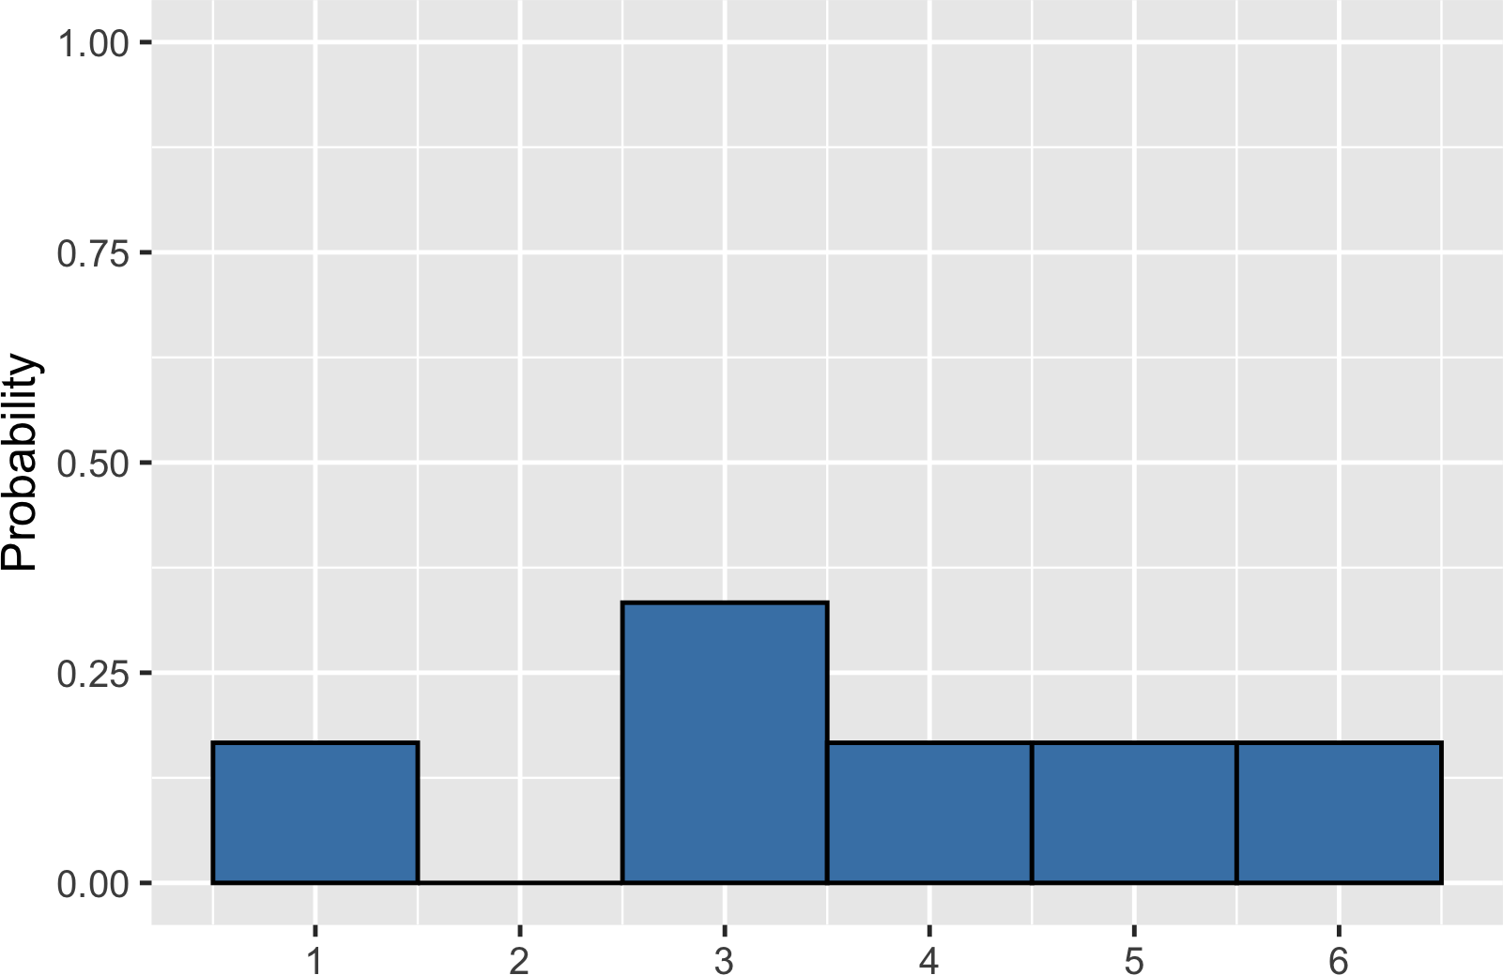
Visualizing uneven probabilities

Slide 33
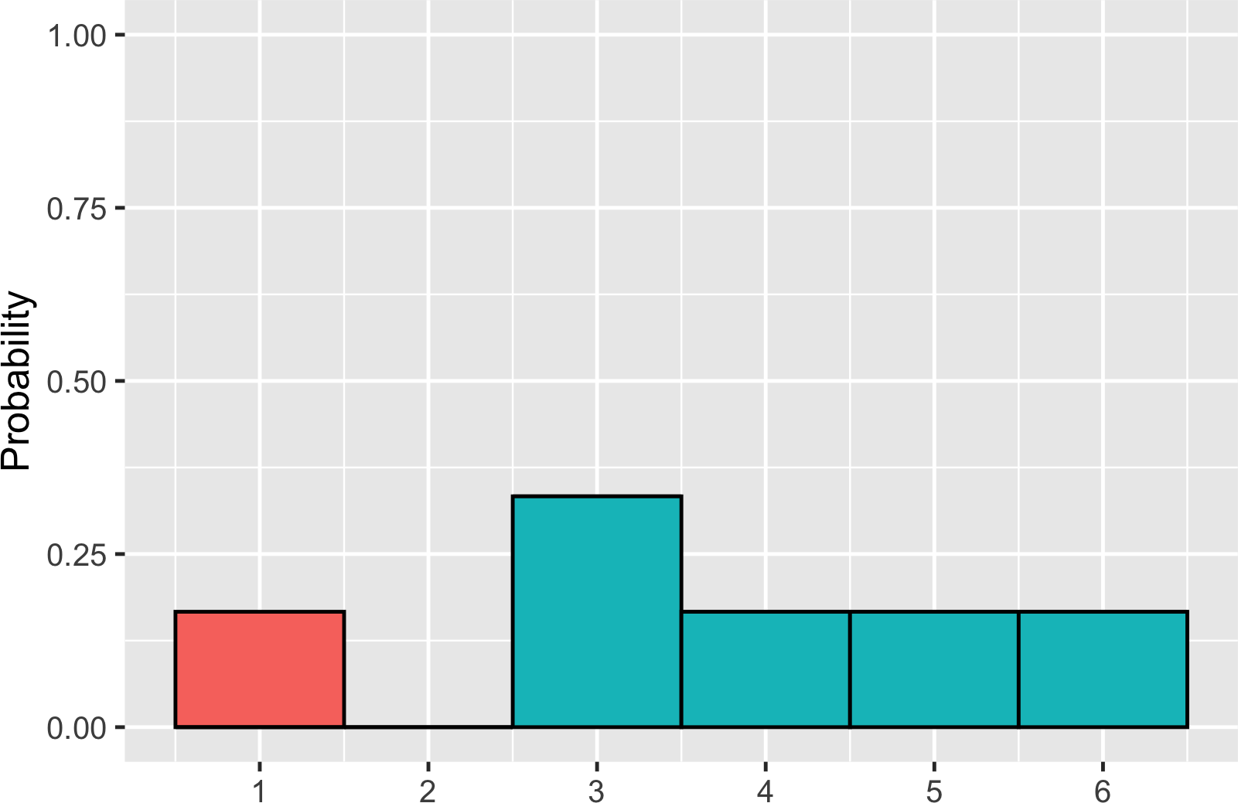
Adding areas
P (uneven die roll) ≤ 2 = ?

Slide 34

Adding areas
P (uneven die roll) ≤ 2 = 1/6

Slide 35
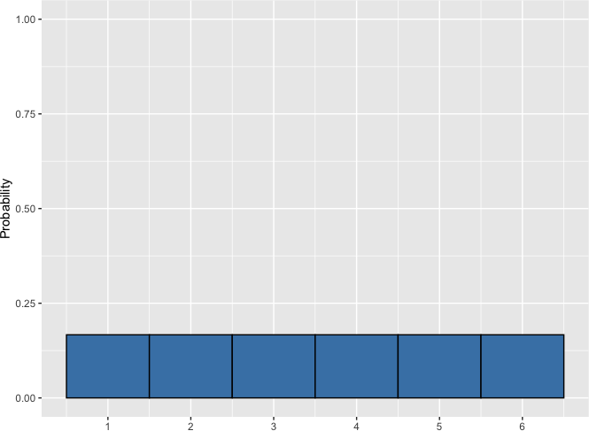
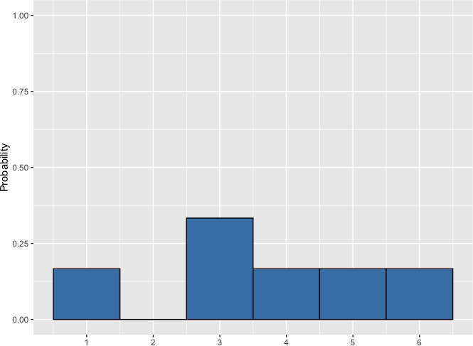
Discrete probability distributions
Describe probabilities for discrete outcomes
Fair die Uneven die
Discrete uniform distribution

Slide 36
Sampling from a discrete distribution
Roll | Result
1 | 1
2 | 2
3 | 3
4 | 4
5 | 5
6 | 6
Roll | Result
1 | 3
2 | 1
3 | 2
4 | 4
5 | 6
6 | 3
7 | 2
8 | 2
9 | 2
10 | 5
Mean = 3.5

Slide 37
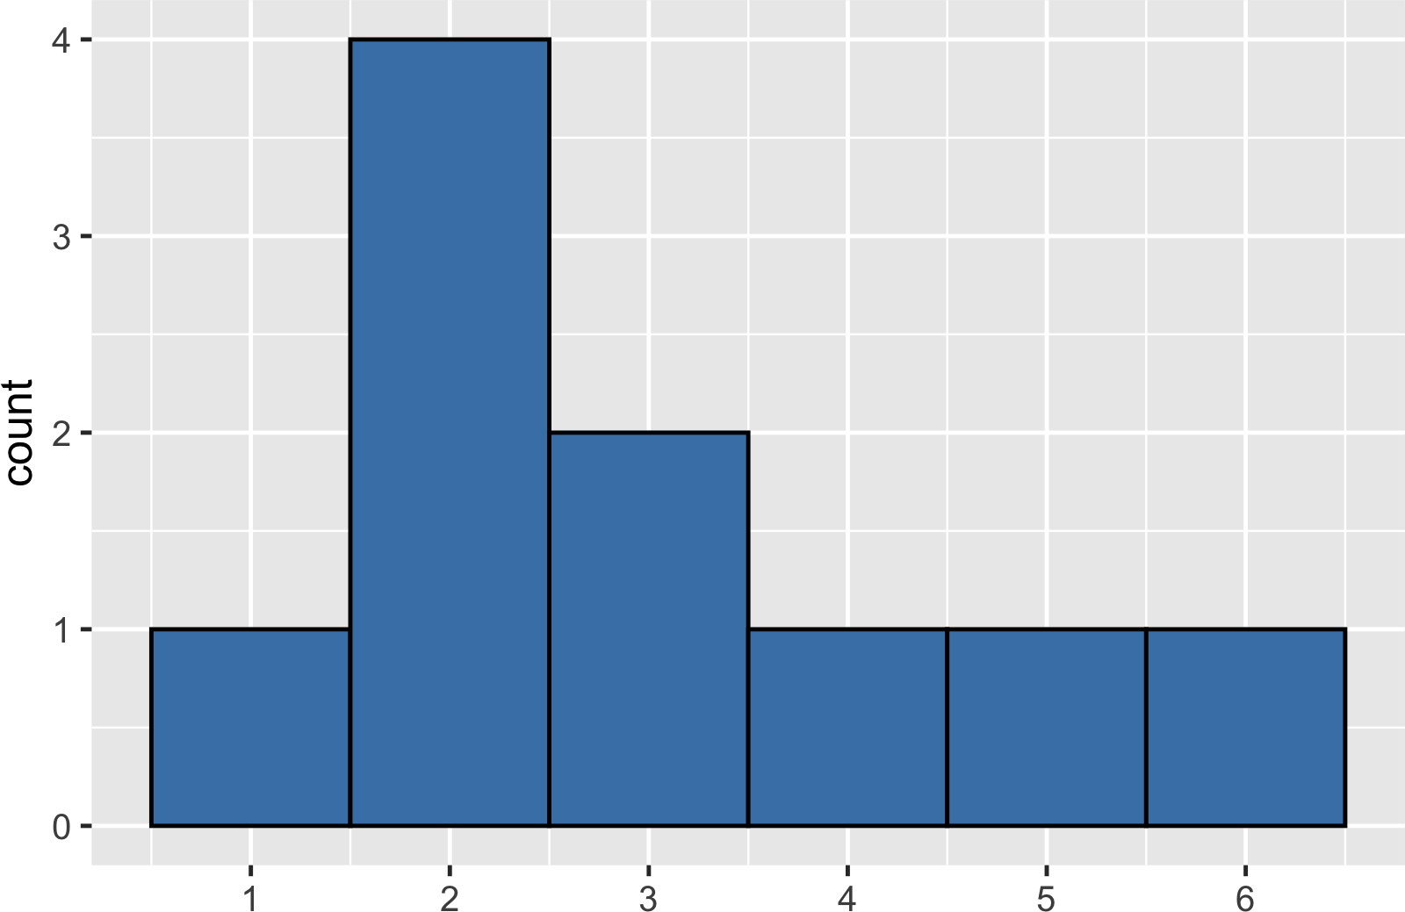
Visualizing a sample

Slide 38
Sample distribution vs theoretical distribution
Mean = 3.0
Mean = 3.5

Slide 39
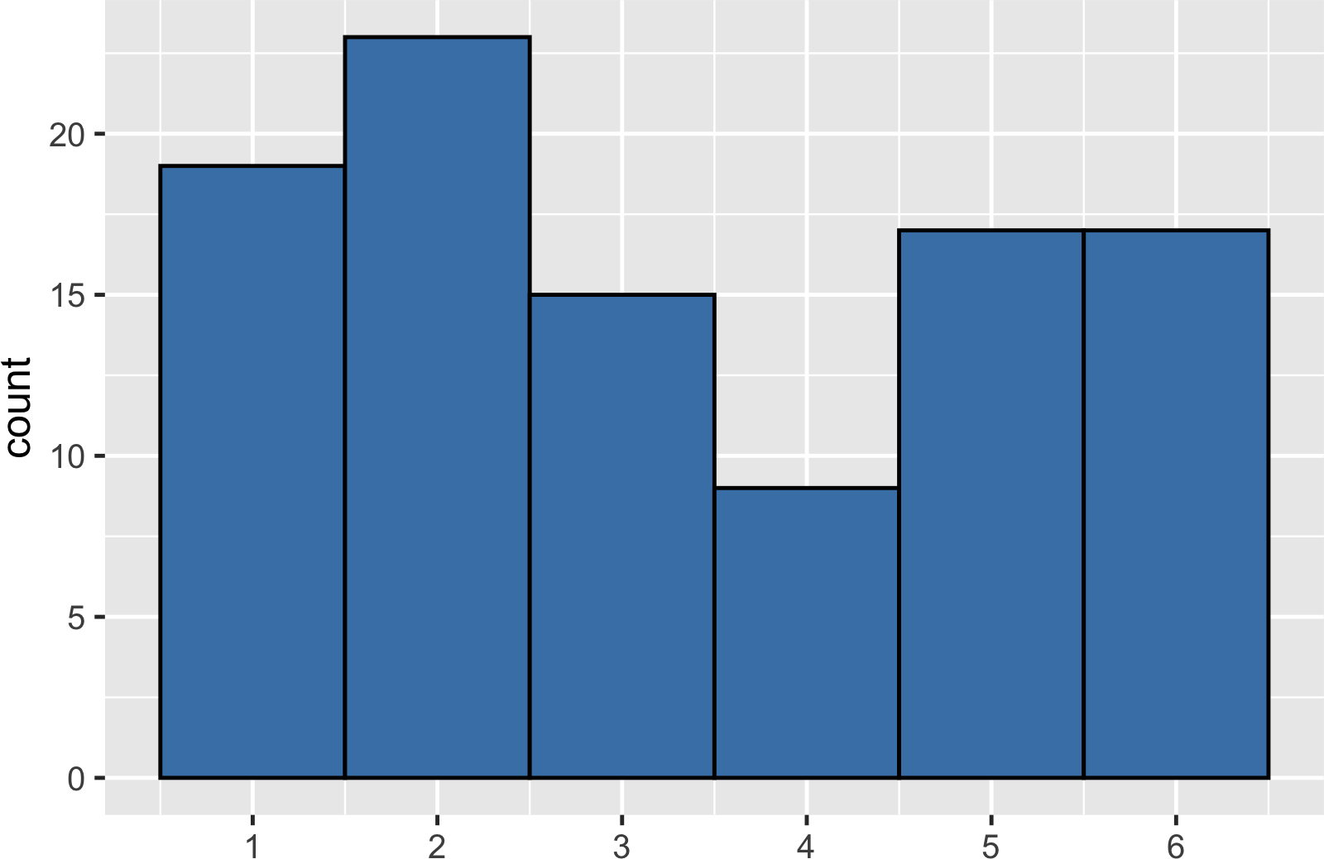
A bigger sample
Sample of 100 rolls
Mean = 3.33

Slide 40
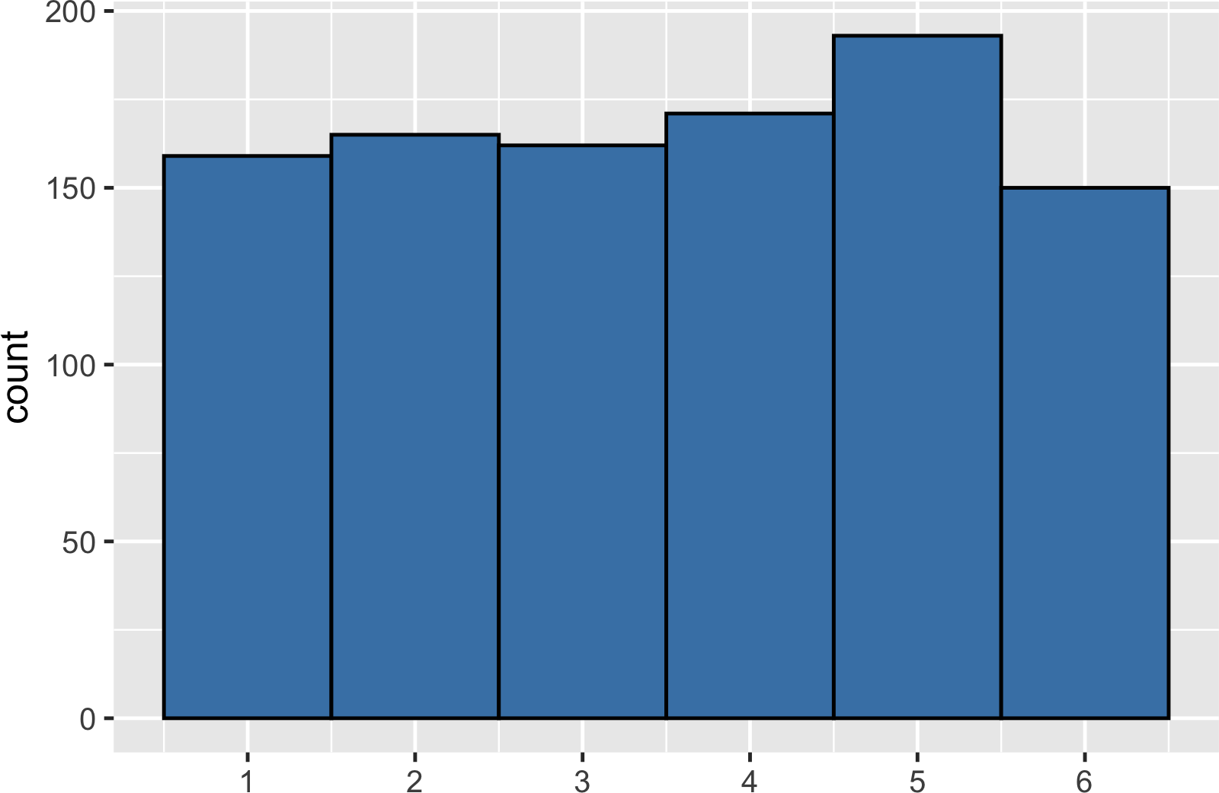
An even bigger sample
Sample of 1000 rolls
Mean = 3.52

Slide 41
Law of large numbers
As the size of your sample increases, the sample mean will approach the expected value.
Sample size | Mean
10 | 3.00
100 | 3.33
1000 | 3.52

Slide 42
Continuous distributions
I N T R O D U C T I O N TO STAT I ST I C S
George Boorman
Curriculum Manager, DataCamp

Slide 43
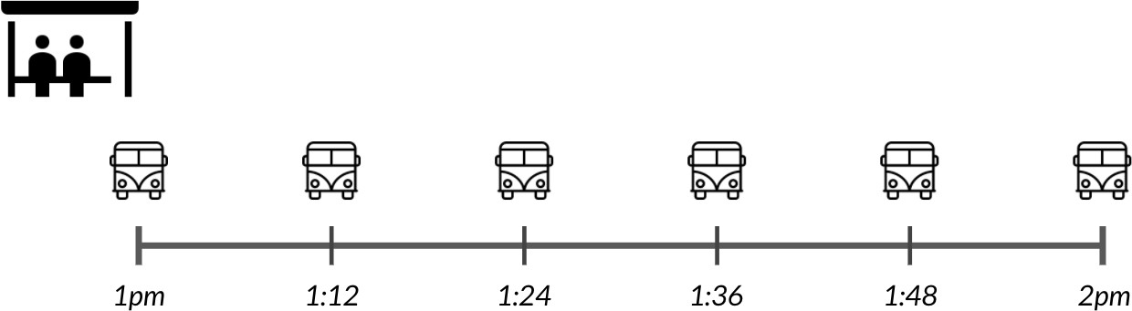
Waiting for the bus

Slide 44
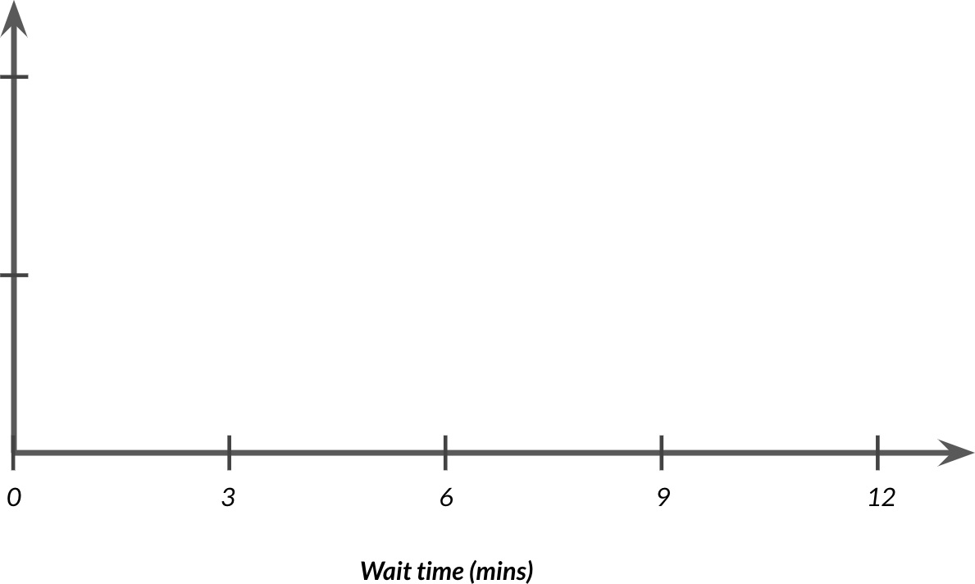
Continuous uniform distribution

Slide 45
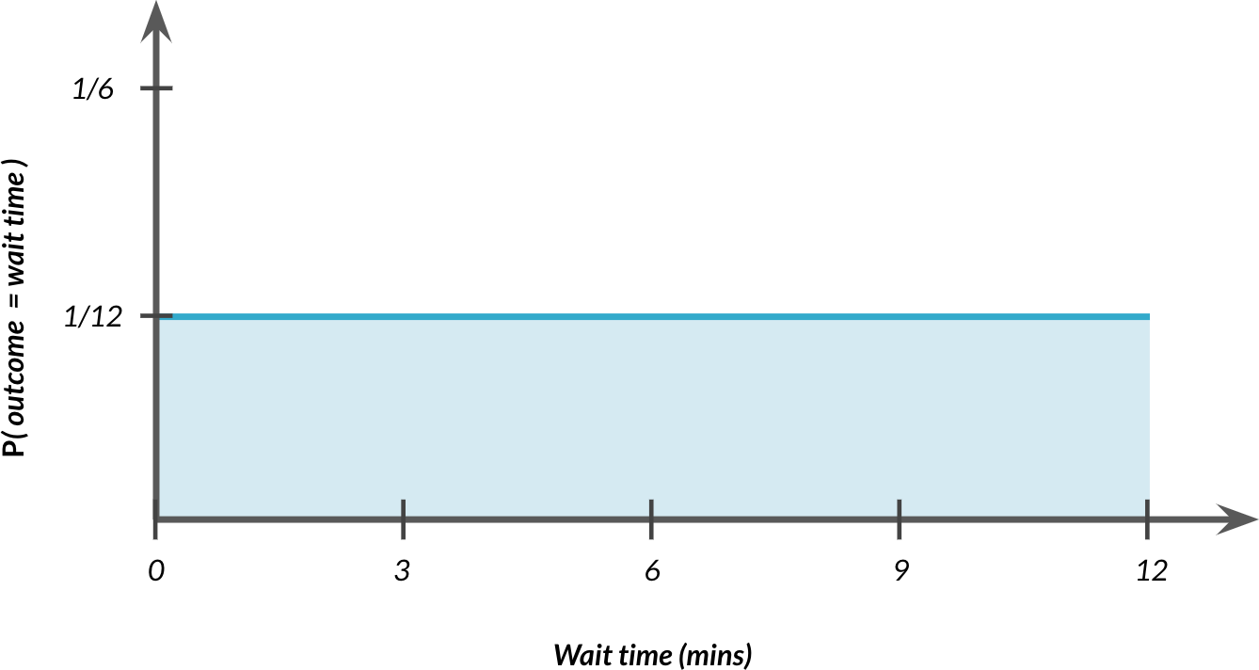
Continuous uniform distribution

Slide 46
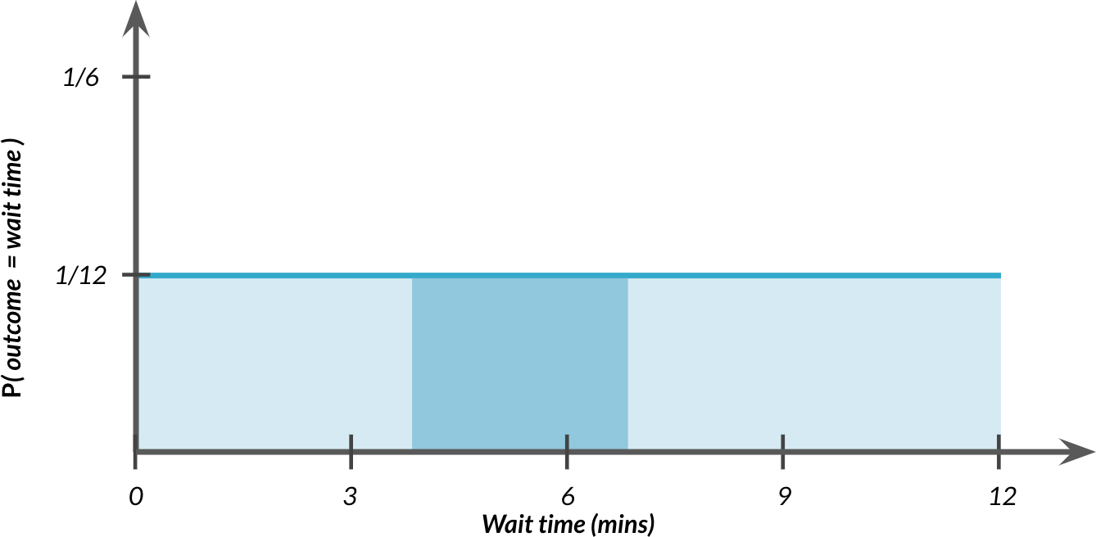
Probability still = area
P (4 ≤ wait time ≤ 7) = ?

Slide 47
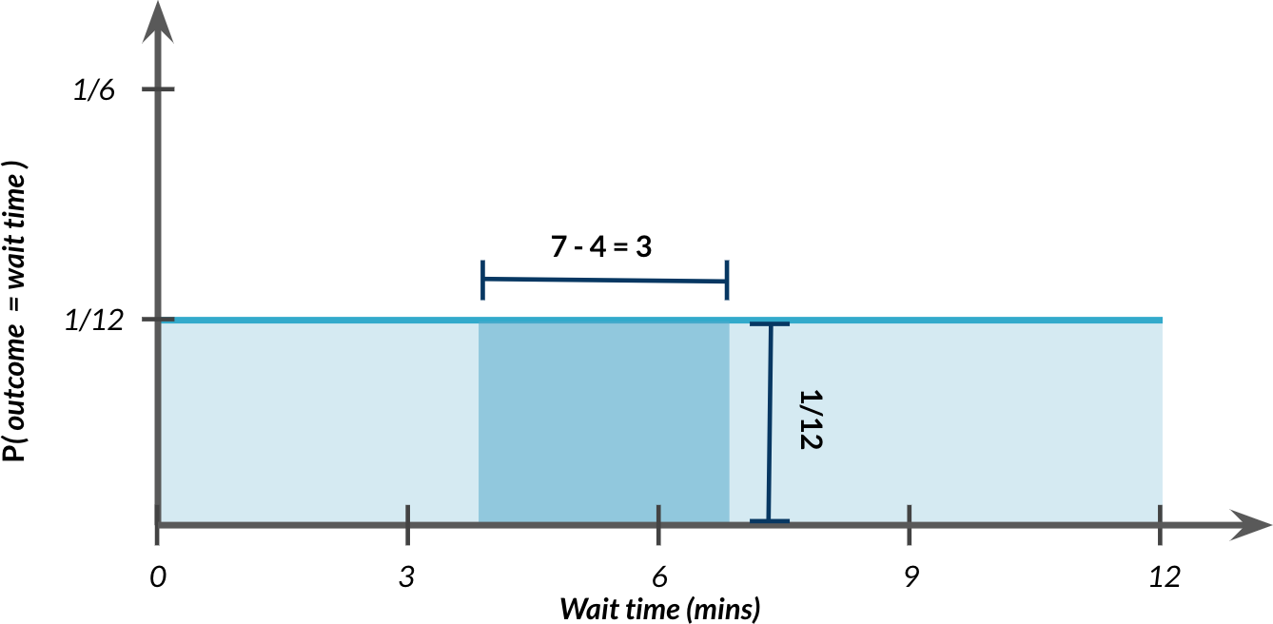
Probability still = area
P (4 ≤ wait time ≤ 7) = ?

Slide 48
Probability still = area
P (4 ≤ wait time ≤ 7) = 3 × 1/12 = 3/12

Slide 49
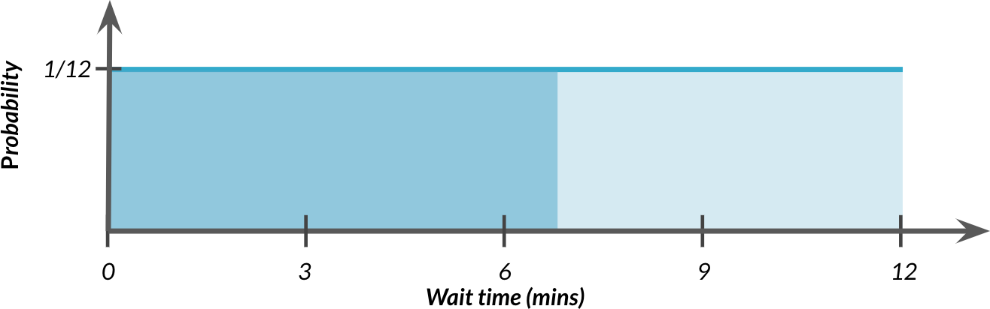
Waiting seven minutes or less
P (wait time ≤ 7) = ?
7 − 0
P (wait time ≤ 7) =
12
7
P (wait time ≤ 7) = ₁₂ = 58.33%

Slide 50
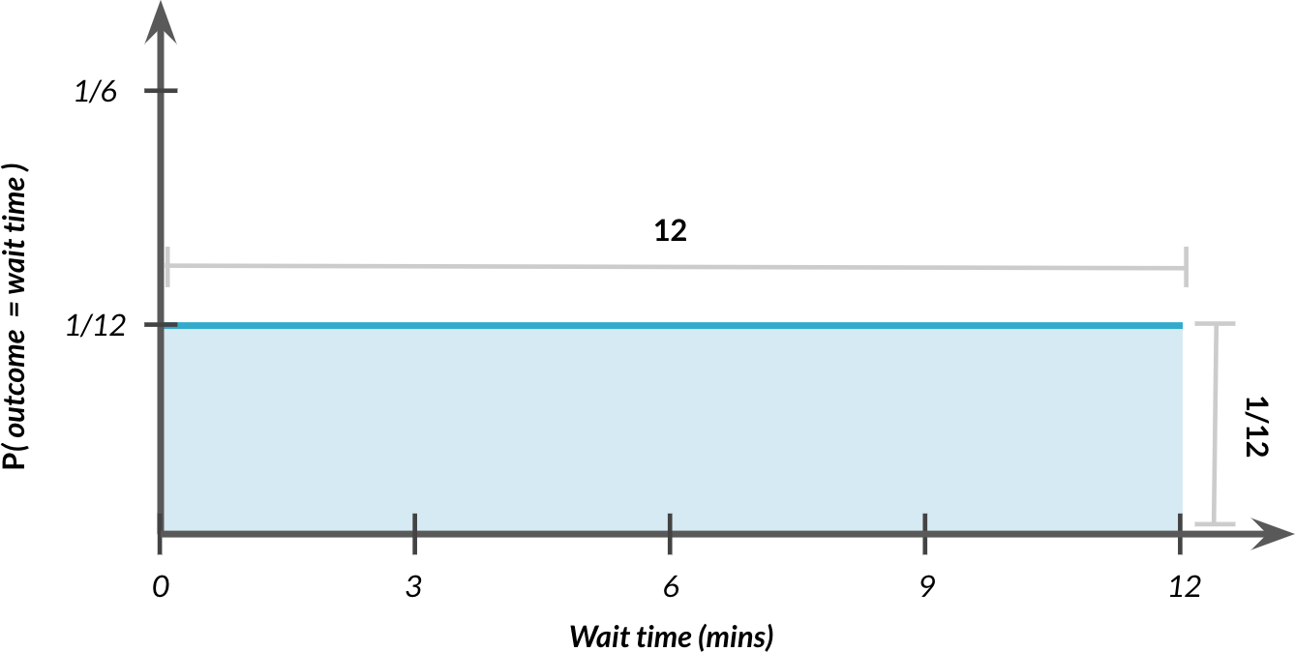
Total area = 1
P (0 ≤ wait time ≤ 12) = ?

Slide 51
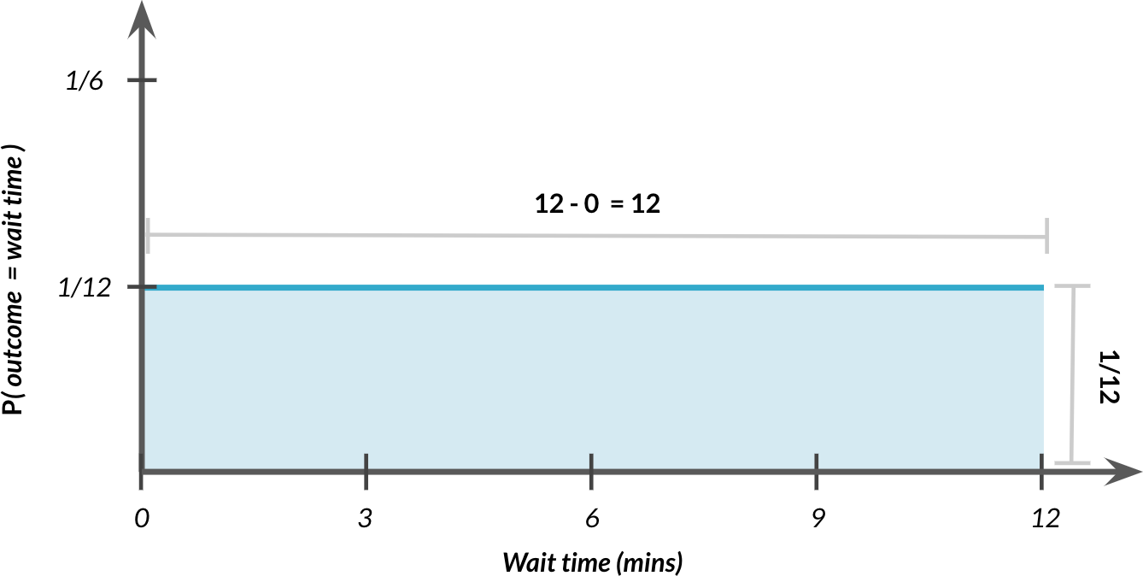
Total area = 1
P (0 ≤ outcome ≤ 12) = 12 × 1/12 = 1

Slide 52
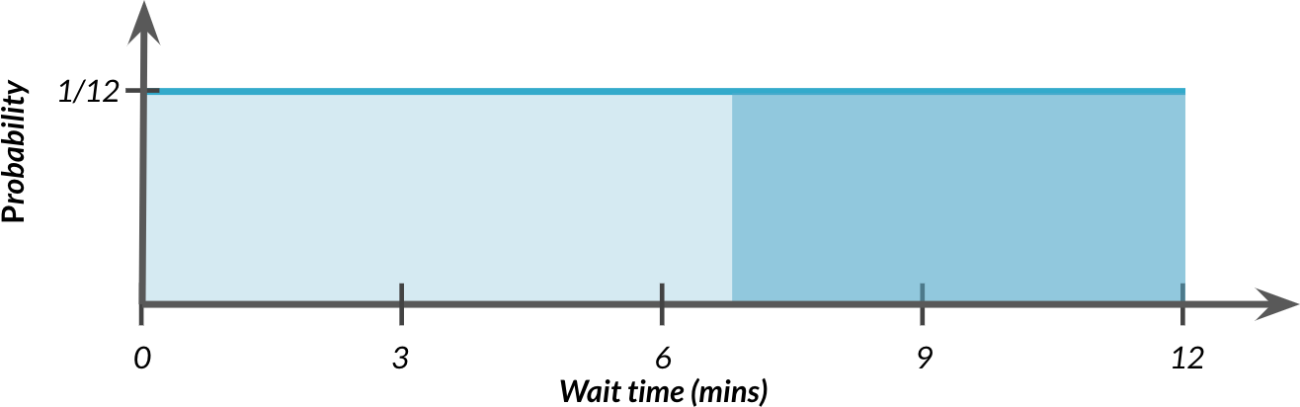
Probability of waiting more than seven minutes
7
P (wait time ≥ 7) = 1 − ₁₂
5
P (wait time ≥ 7) = ₁₂ = 41.67%

Slide 53
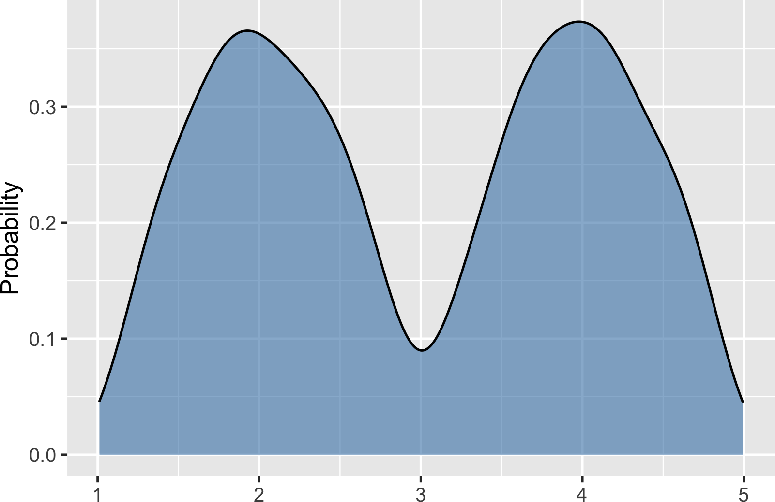
Bimodal distribution

Slide 54
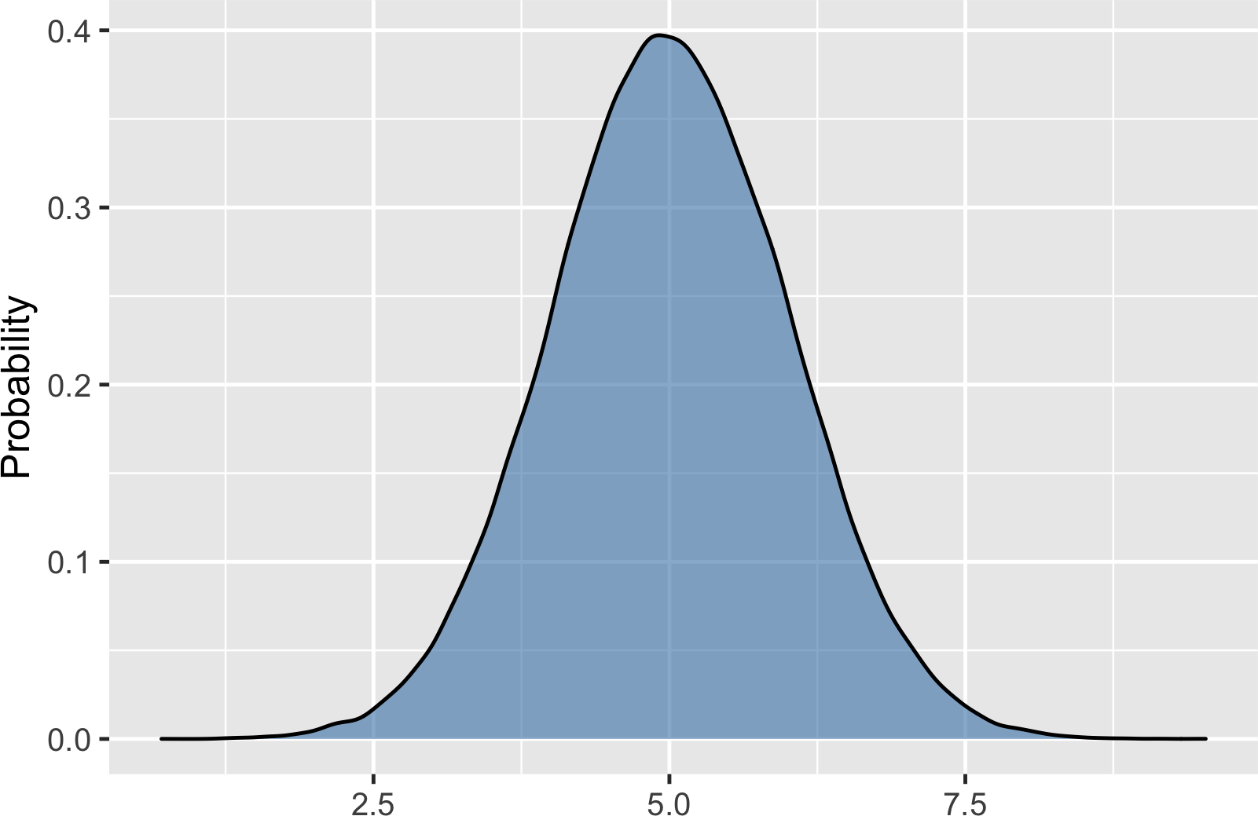
The normal distribution

Slide 55


Total area still = 1

